Slide 1
Canvas for the Nature I

Slide 2

Fractal 碎形
碎形在所有的大小尺度下都顯得相似，所以通常被認為是無限複雜的。自然界裡一定程度上類似碎形的事物有雲、山脈、閃電、海岸線、雪片、植物根、多種蔬菜（如花椰菜和西蘭花）和動物的毛皮的圖案等等。
(source:https://zh.wikipedia.org/zh-tw/%E5%88%86%E5%BD%A2)

Slide 3
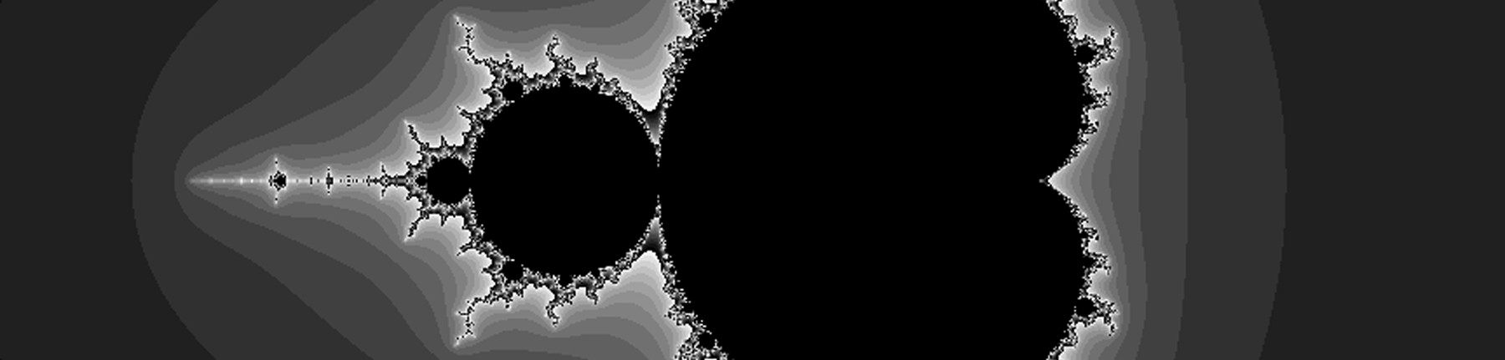
Mandelbrot set

Slide 4

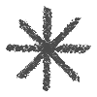
Outlines
The power of recursion
The circles Recursive Tree Pythagorean Tree Koch Curve

Slide 5


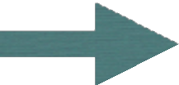
HTML Canvas Skeleton code
<!DOCTYPE html>
<html><body>
<canvas id="fractal" width="300" height="300" style="border:1px solid #000000;"></canvas>
<script>
// 取得canvas
var canvas =
document.getElementById("fractal");
// 取得⽤來描繪的上下⽂
var ctx = canvas.getContext("2d");
// 定義描繪矩形的⽅法
</script>
</body></html>

Slide 6
Monster Curve
The Power of Recursive for generating Curves
such fractal objects were mathematical monster

Slide 7
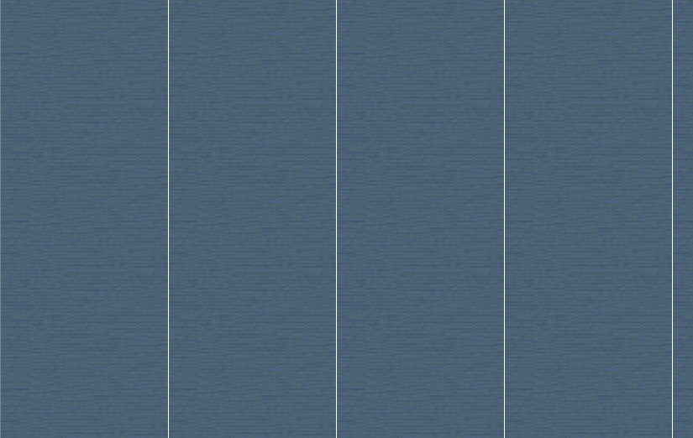
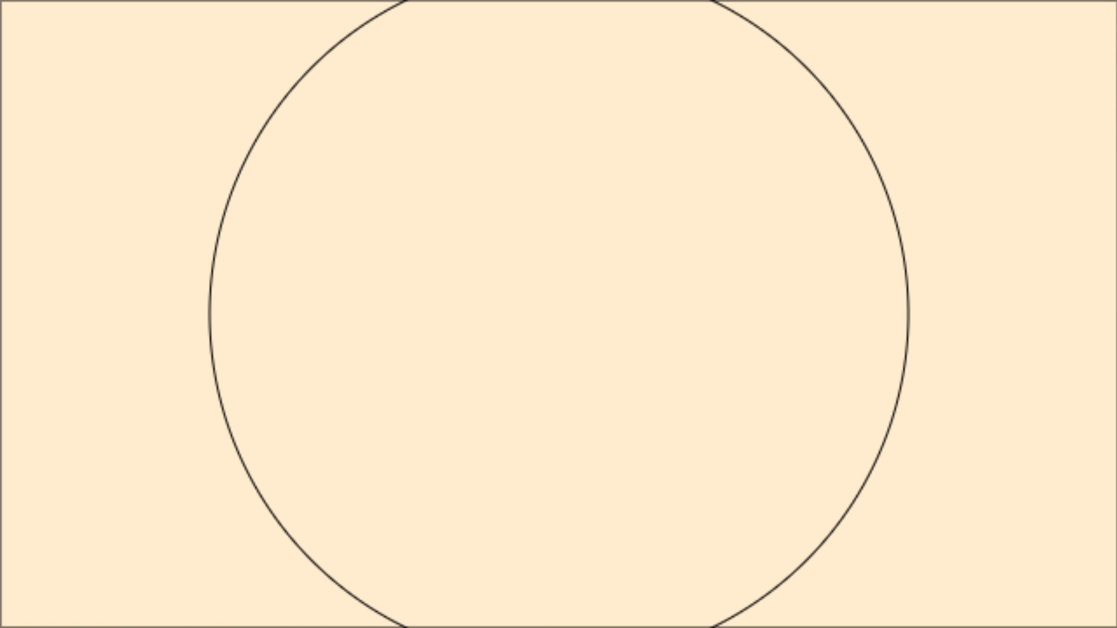
Step 1
var canvas = document.getElementById("fractal");
var ctx = canvas.getContext('2d');
drawCircle(320, 180, 200);
ctx.strokeRect(0, 0, 640, 360);
function drawCircle(x, y, r) {
ctx.beginPath();
ctx.arc(x, y, r, 0, 2 * Math.PI); ctx.stroke();
}

Slide 8
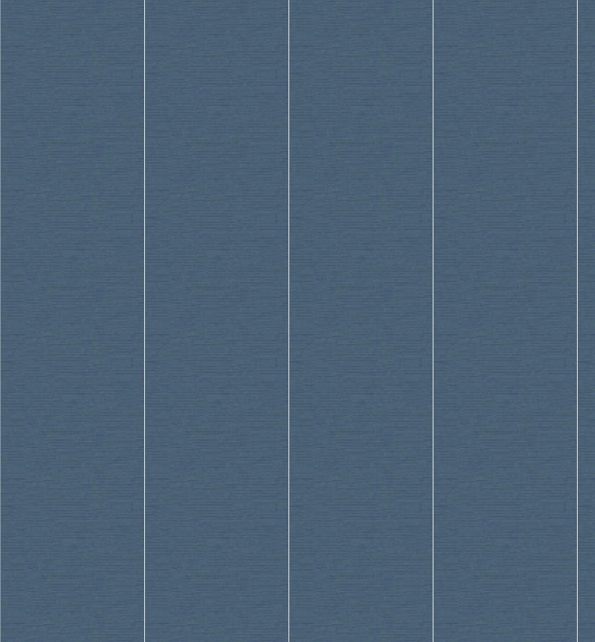
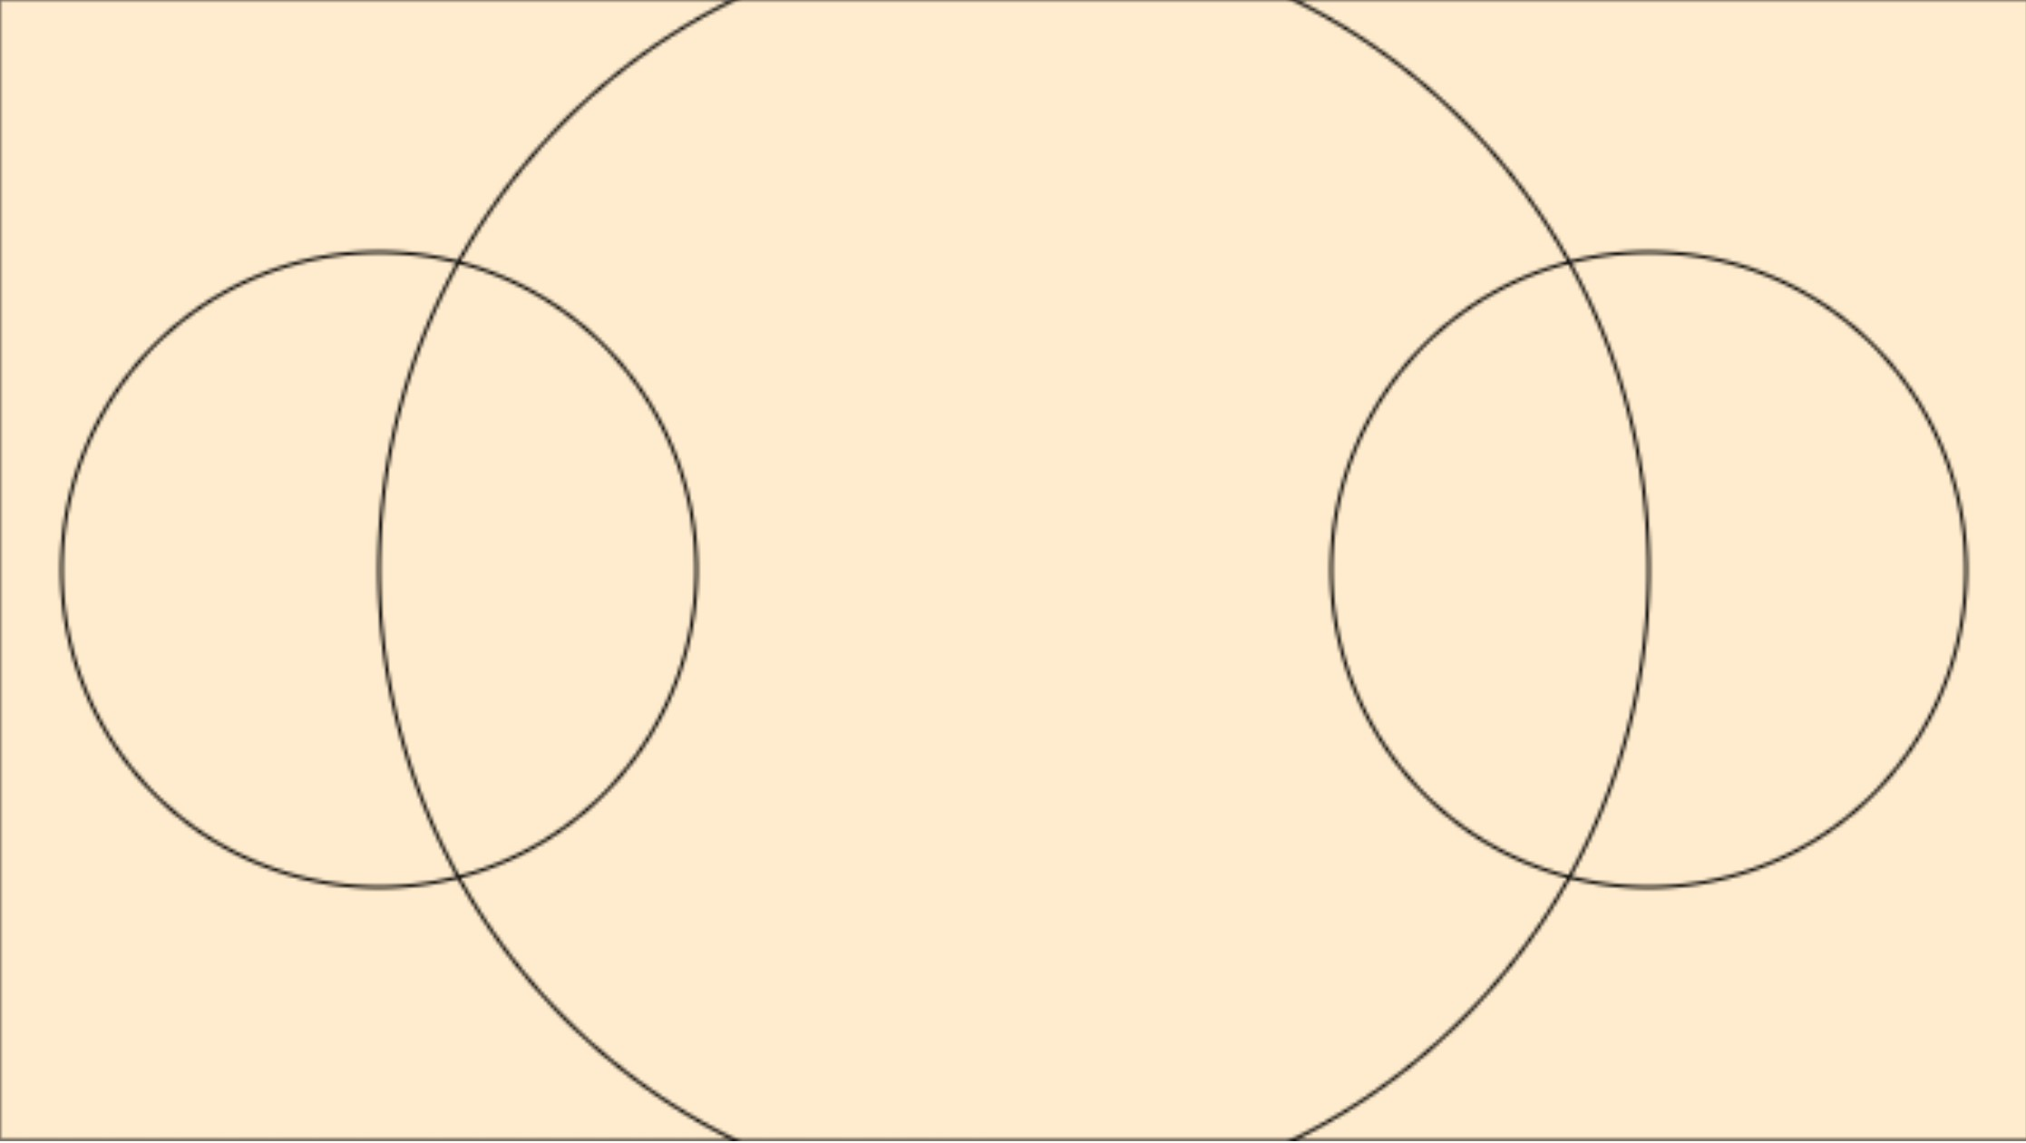
Step 2
var canvas = document.getElementById("fractal");
var ctx = canvas.getContext('2d');
drawCircle(320, 180, 200);
ctx.strokeRect(0, 0, 640, 360);
function drawCircle(x, y, r) {
ctx.beginPath();
ctx.arc(x, y, r, 0, 2 * Math.PI); ctx.stroke();
ctx.beginPath();
ctx.arc(x-r, y, r/2, 0, 2 * Math.PI); ctx.stroke();
ctx.beginPath();
ctx.arc(x+r, y, r/2, 0, 2 * Math.PI); ctx.stroke();
}

Slide 9
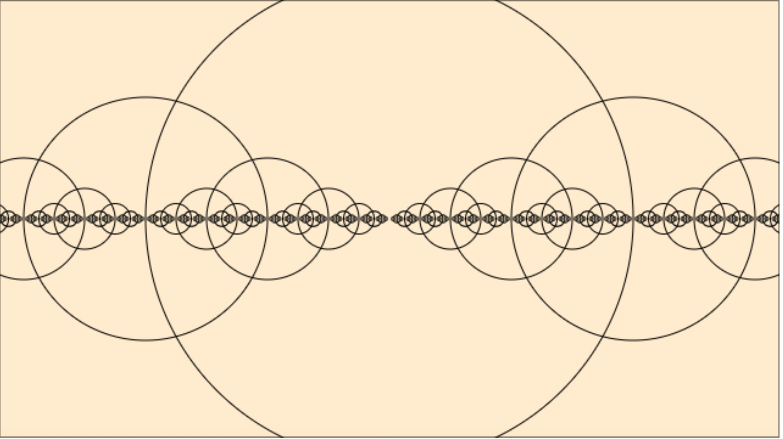
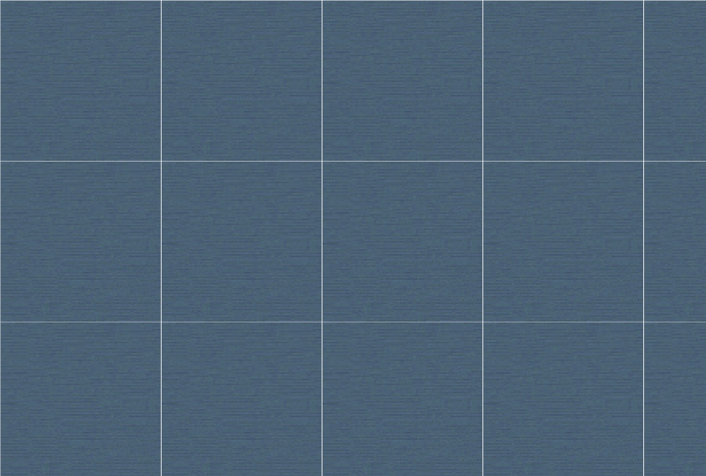
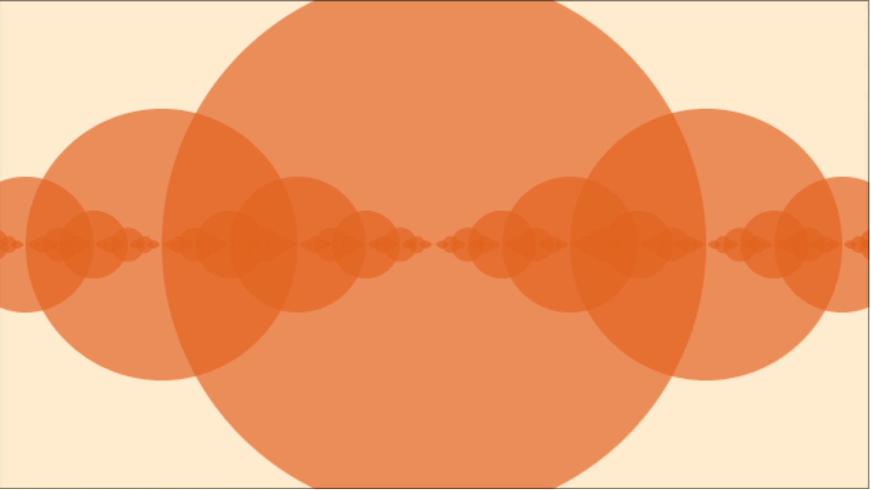
Step 3: Recursive
function drawCircle(x, y, r) {
ctx.beginPath();
ctx.arc(x, y, r, 0, 2 * Math.PI); ctx.stroke();
if (r > 2) { // condition for drawing similarity
drawCircle(x + r, y, r / 2);
drawCircle(x - r, y, r / 2);
}
}

Slide 10
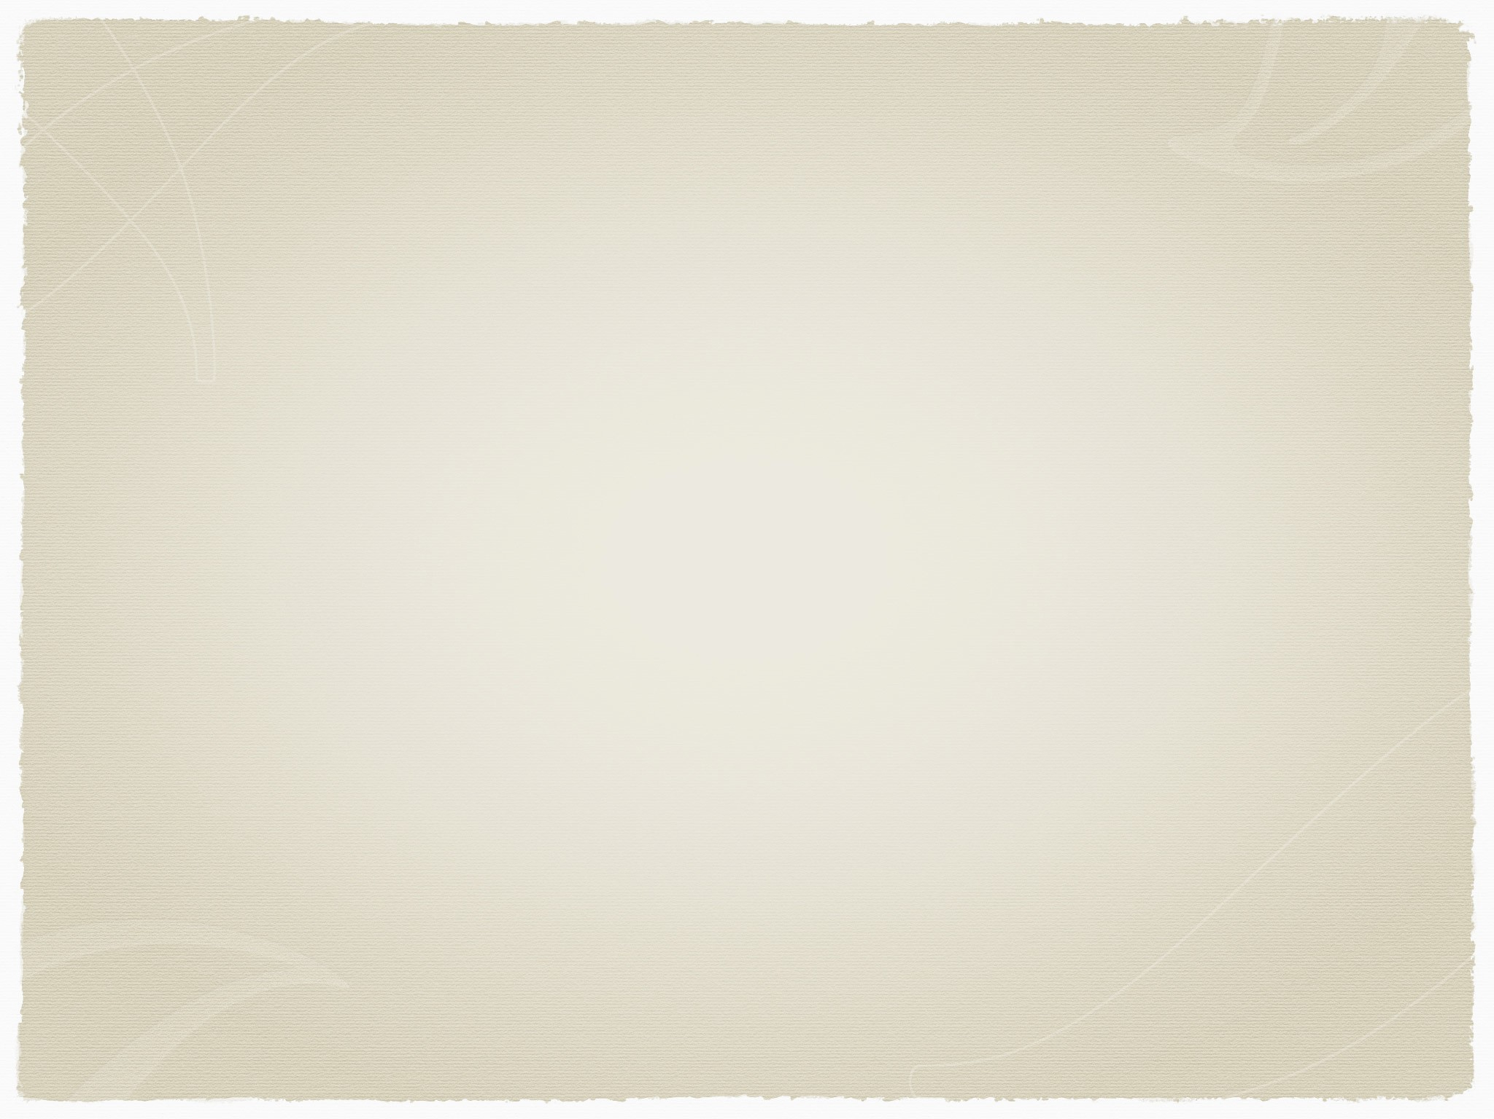
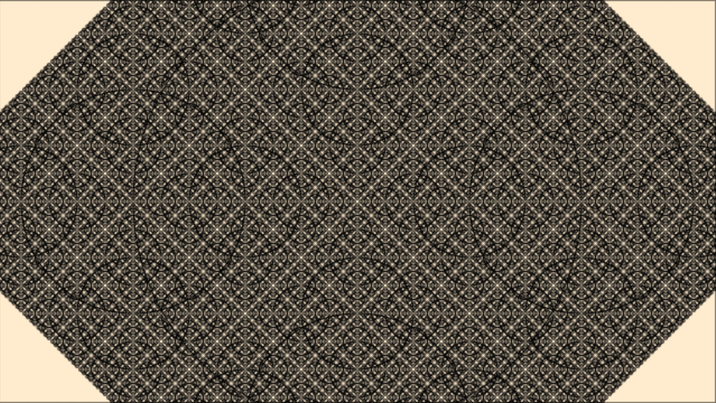
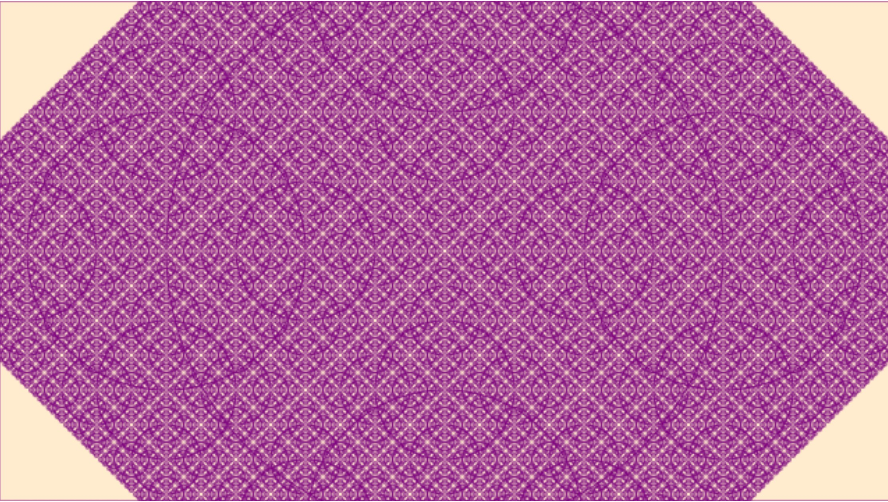
Step 3: add two branches
ctx.strokeStyle

Slide 11
The Recursive Tree

Slide 12
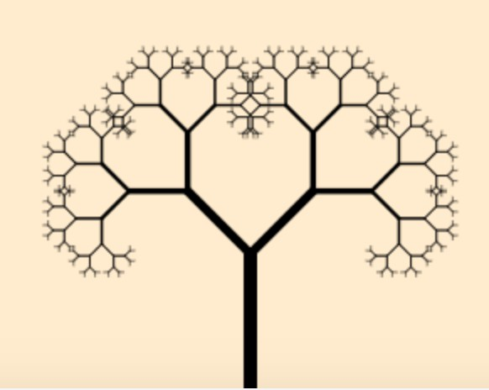
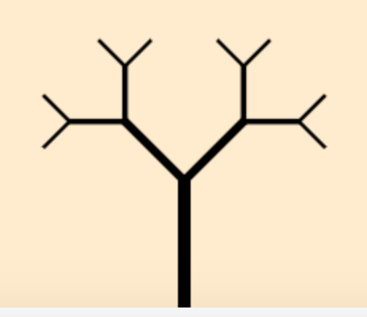
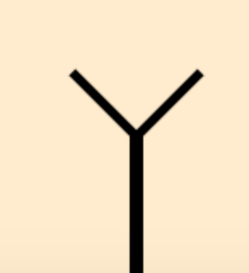
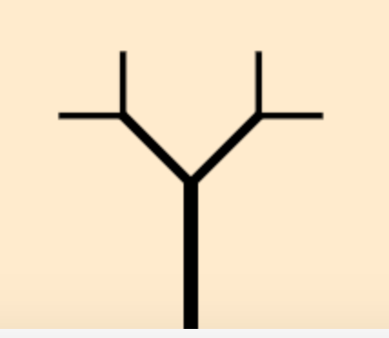
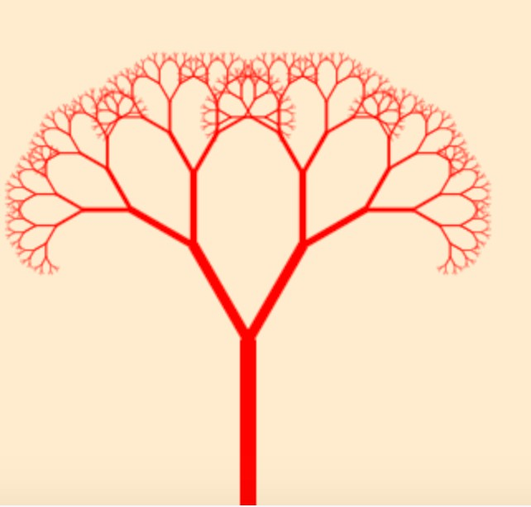
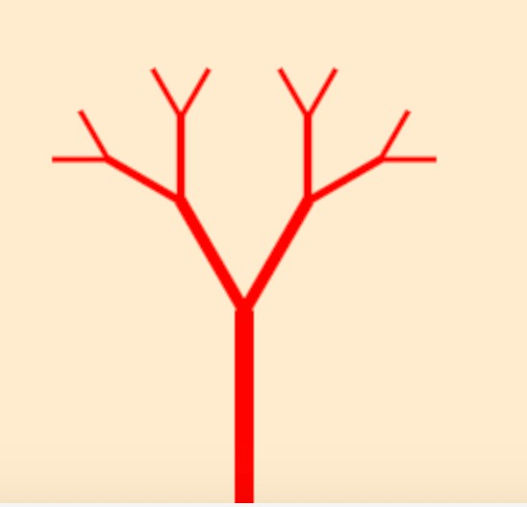
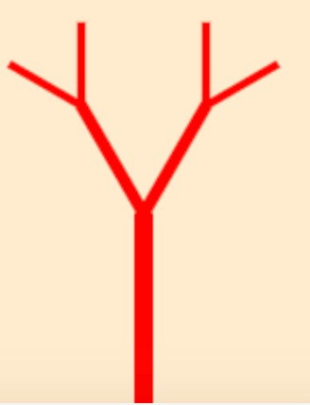
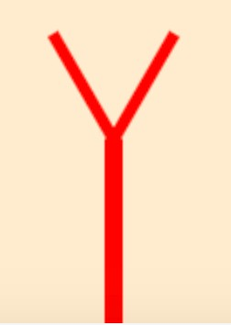

Slide 13
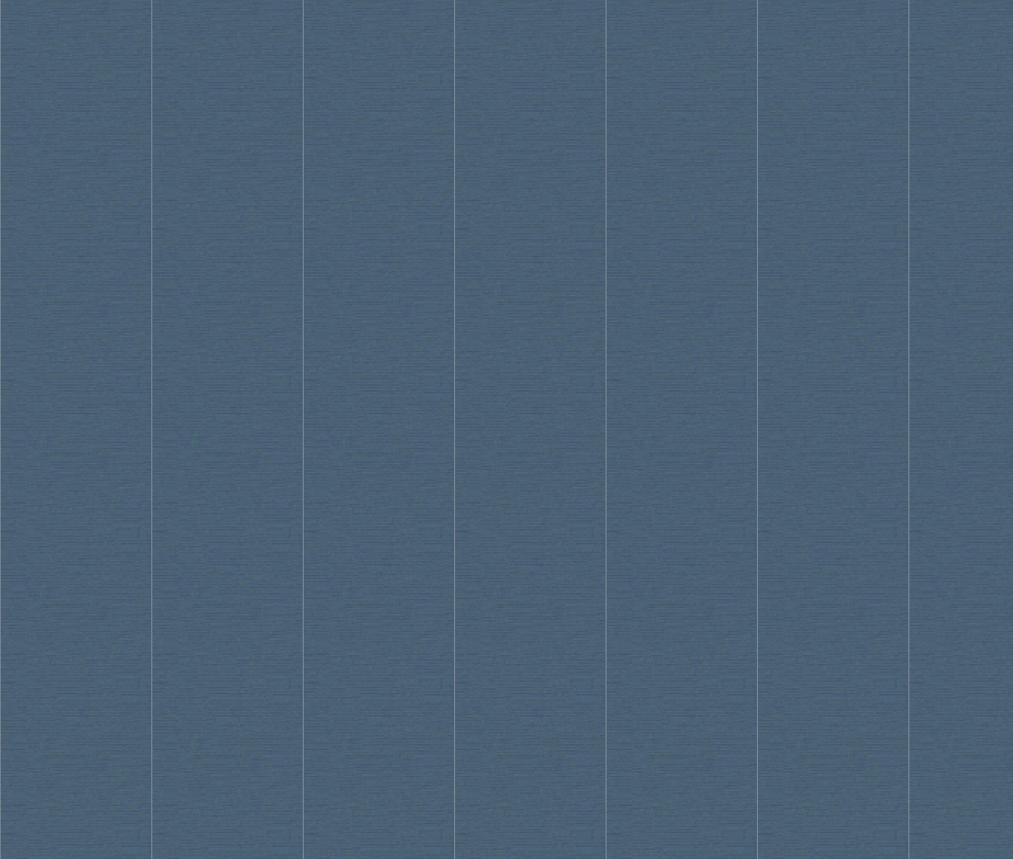
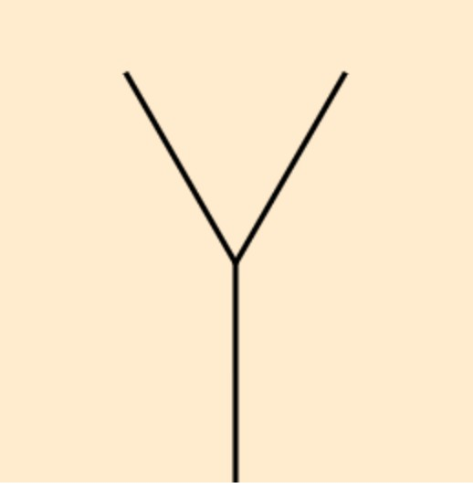
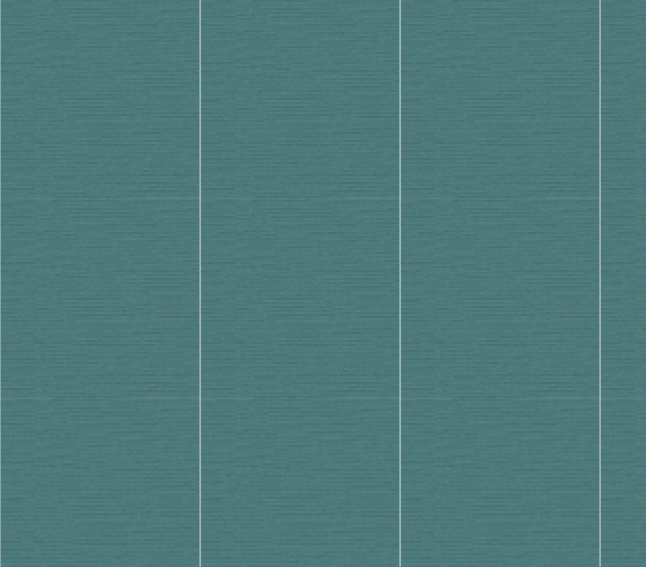
Step 1
var canvas = document.getElementById("fractal");
var ctx = canvas.getContext('2d');
ctx.translate(canvas.clientWidth / 2, canvas.clientHeight);
var len = 120;
var theta = 30;
line(0, 0, 0, -len);
ctx.translate(0, -len);
// move coordinate frame to the tree top
ctx.save();
ctx.rotate(Math.PI / 180 * theta);
line(0, 0, 0, -len);
ctx.restore();
ctx.save();
this.ctx.rotate(-Math.PI / 180 * theta);
line(0, 0, 0, -len);
ctx.restore();
function line(x1, y1, x2, y2,width=3) {
ctx.strokeStyle = this.color;
ctx.lineWidth = width;
ctx.beginPath();
ctx.moveTo(x1, y1);
ctx.lineTo(x2, y2);
ctx.closePath();
ctx.stroke();
}

Slide 14
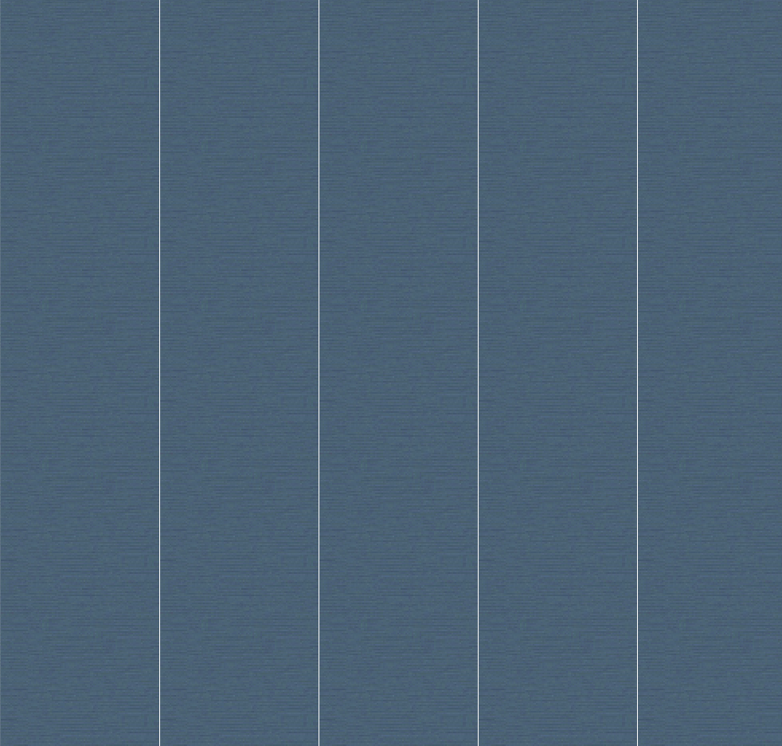
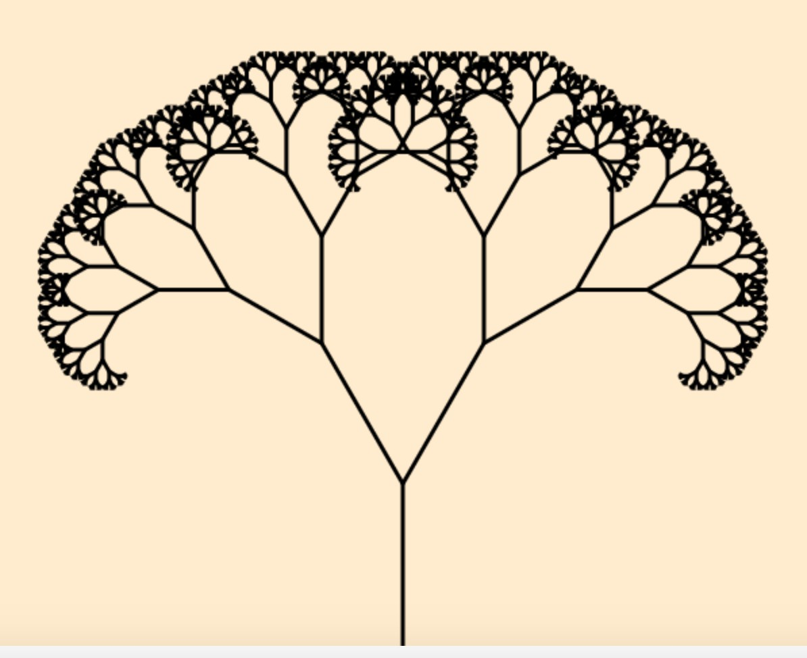
Step 2: draw subtree with branch
function branch(len) {
line(0, 0, 0, -len);
ctx.translate(0, -len);
len *= 0.66;
if (len > 2) {
// right branch
ctx.save();
ctx.rotate(Math.PI / 180 * theta);
branch(len);
ctx.restore();
// left branch
ctx.save();
ctx.rotate(-Math.PI / 180 * theta);
branch(len);
ctx.restore();
}
}

Slide 15
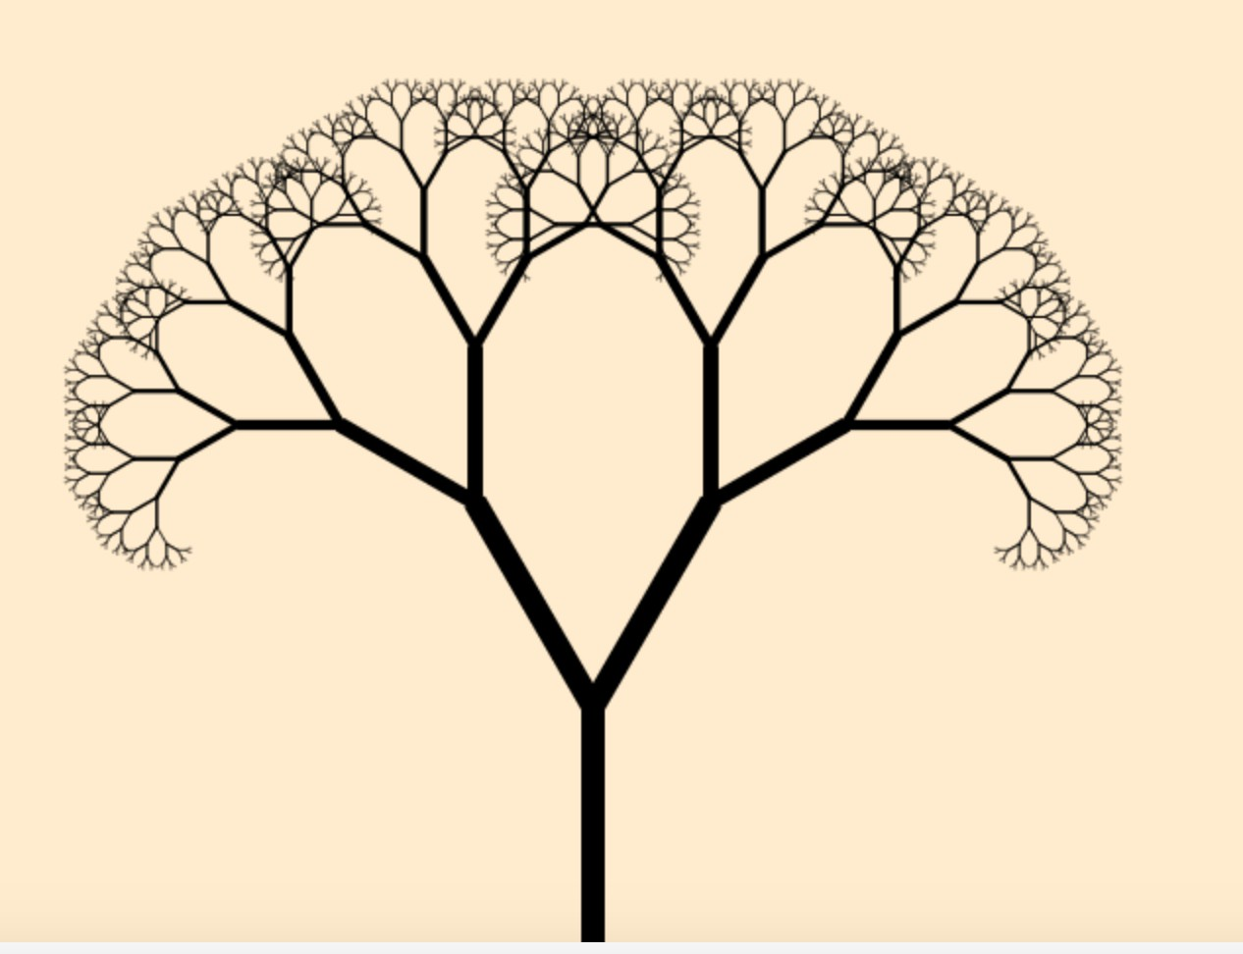
Step 3: draw branch with diﬀerent trunk size
Diﬀerent trunk size

Slide 16
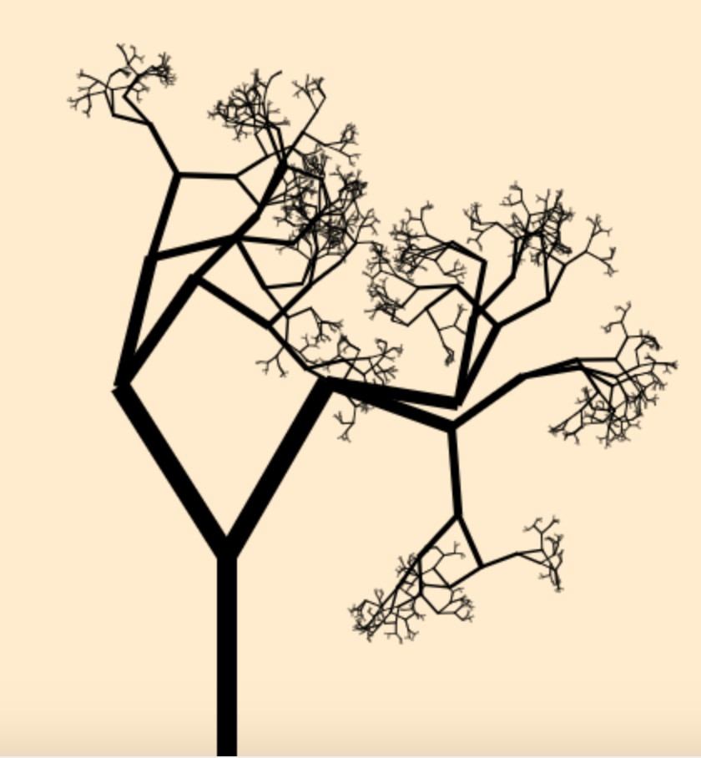
Step 3: draw branch with diﬀerent angles
Diﬀerent trunk angles

Slide 17
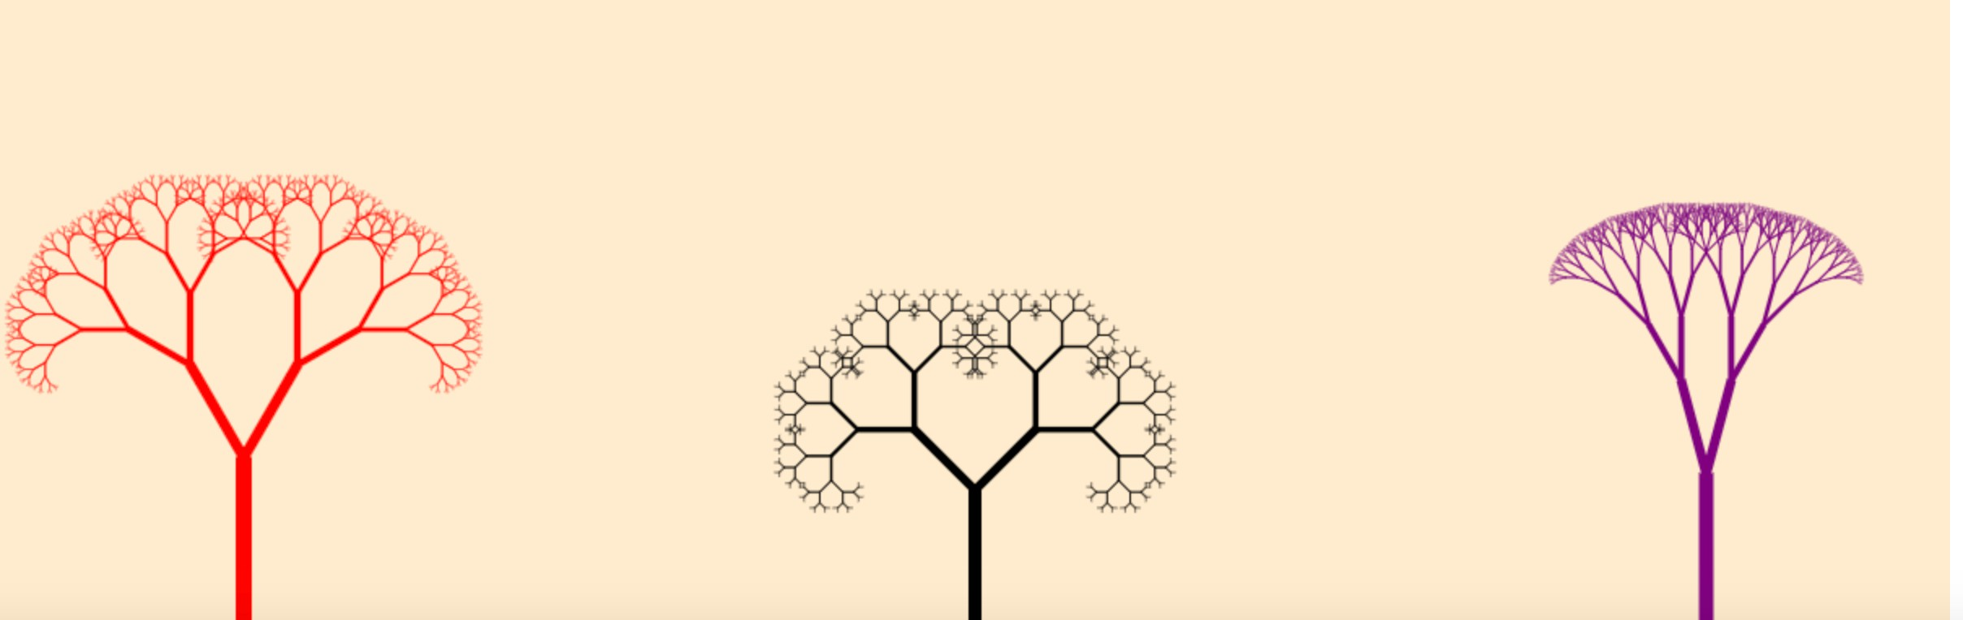
Step4 : make forest using class
var canvas = document.getElementById("fractal");
var ctx = canvas.getContext('2d');
ctx.translate(canvas.clientWidth / 2, canvas.clientHeight);
var len = 120;
var theta = 30;
branch();
加上for迴圈, 並重置每棵樹的起點
數高、顏色、樹枝角度寬度皆可利用Math.random()變化

